Slide 1

WELCOME TO
By Stevenson Michel
CSC 493 - Computing Design Practicum
October 14th, 2024

Slide 2
WHAT IS BUCK$?
PROBLEMS TO SOLVE
Personal finance management
Difficulty in tracking expenses
Budgeting challenges
GOALS OF THE APPLICATION
Help users track expenses
Manage budgets
Gain financial insights).

Slide 3
KEY FEATURES
Expense Categorization
Budget Tracking
Expenses management
Integrations with banks
Notifications
Insights on spending trends

Slide 4
TECHNOLOGY STACK
-FRONTEND
-FRONTEND
React.JS
TypeScript
React.JS
TypeScript
MIDDLEWARE
DATABASES
CorsHeaders
MySQL

Slide 5
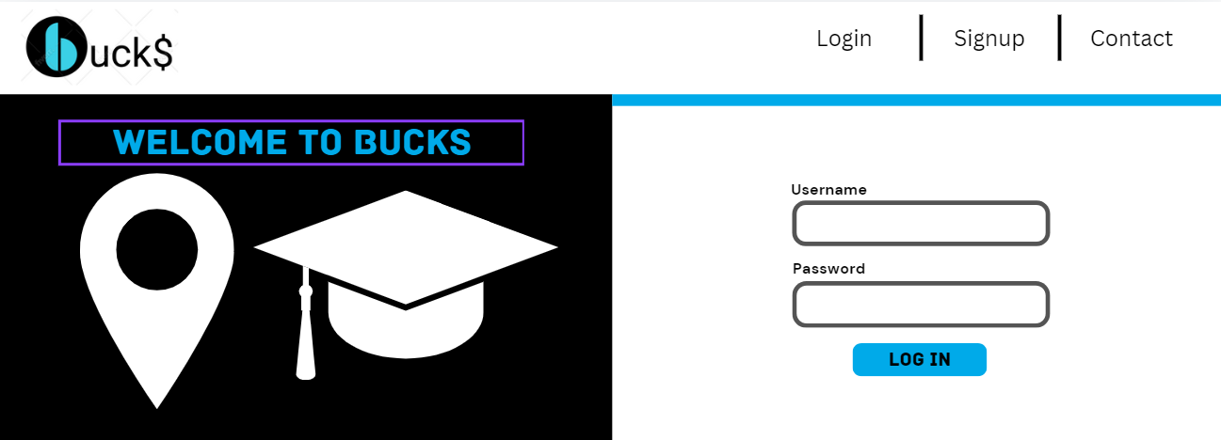
FEATURES’ SHOWCASE

Slide 6
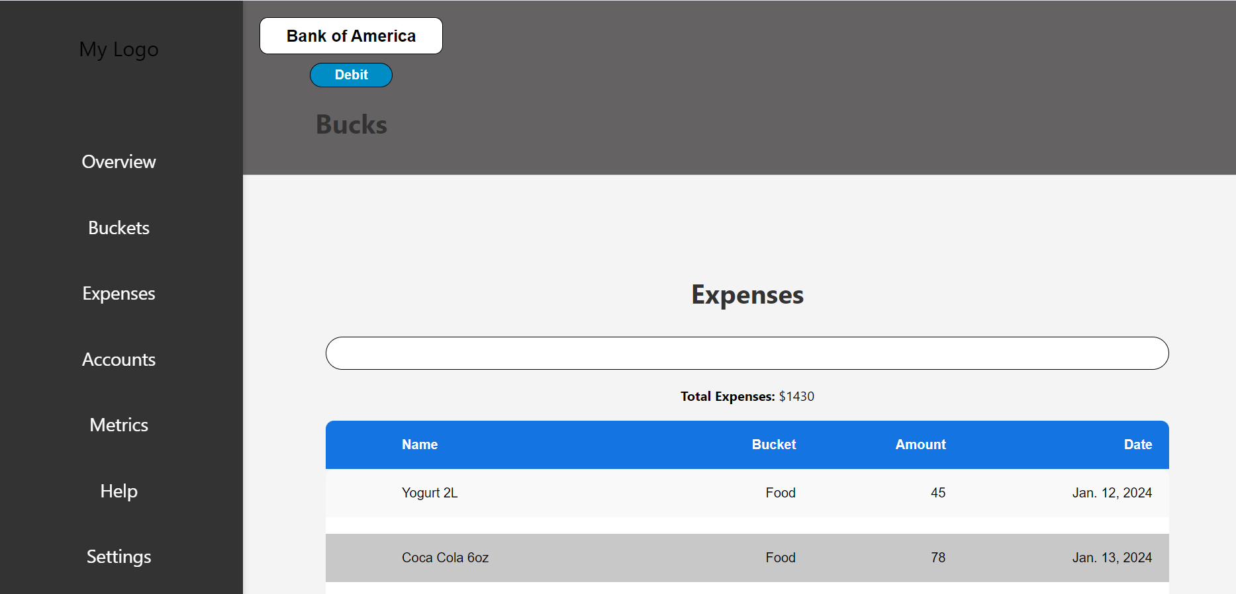
FEATURES’ SHOWCASE

Slide 7
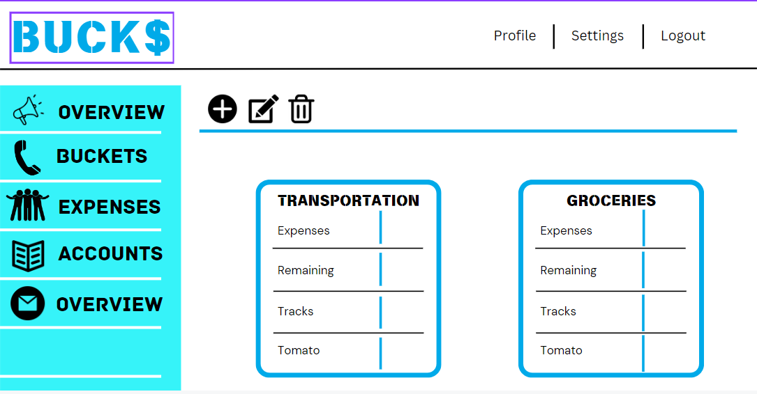
INTERFACE

Slide 8
FUTURE IMPROVEMENTS
Completion of Core Features
User Interface Improvement
Consistent User Authentication
Immediate User Feedback
Testing Planning Process
Integrations with several banks

Slide 9
FINAL SAY
ACKNOWLEDGEMENTS
Professor Wilborne
Classmates
THANK YOU!!!

